Slide 1
What will we be exploring today?
We will start with HASHING.
Then we will explore Authentication & Authorization.
We will understand
Sessions
Cookies
Session Management [Traditional]
JWT & Why we need them & session management with JWT
Refresh Tokens
Problems with JWT
Redis
Followed by SSO and Passport.js
But before all that let’s hear a very Silly joke (that I spent 13 minutes finding).

Slide 2
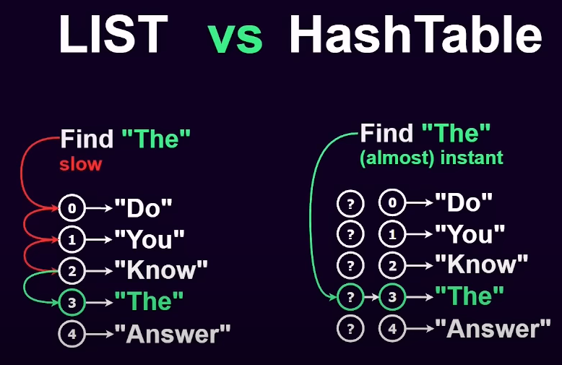

Slide 3
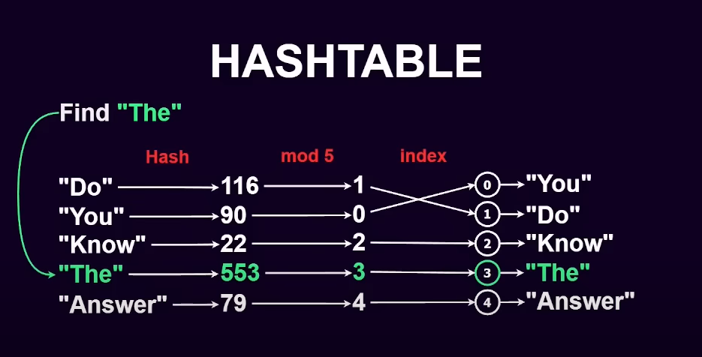

Slide 4
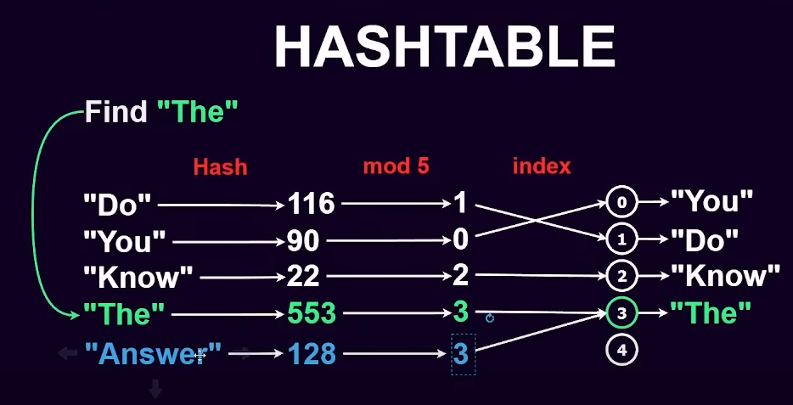

Slide 5
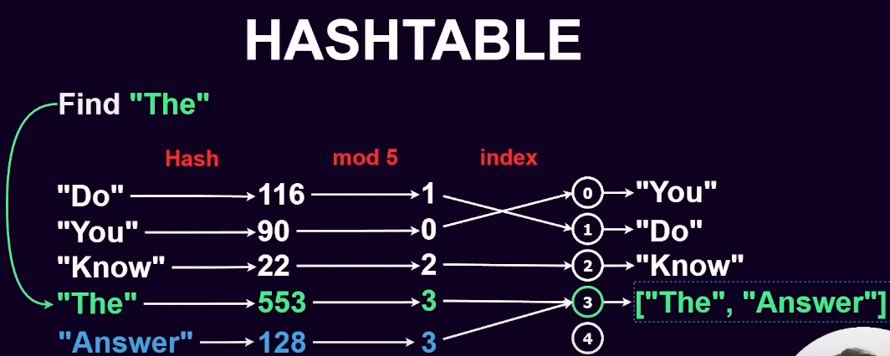

Slide 6
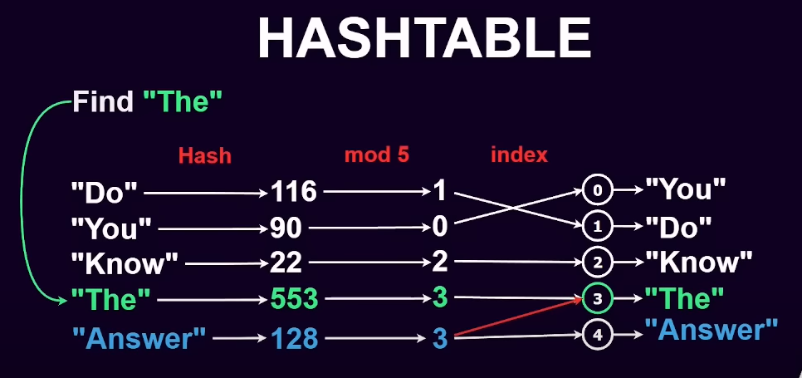

Slide 7
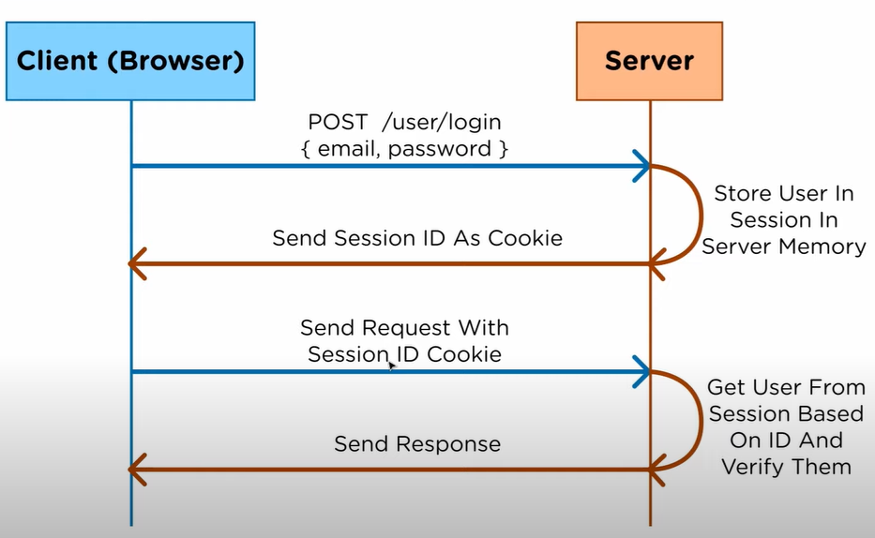
Cookie Based Authentication

Slide 8
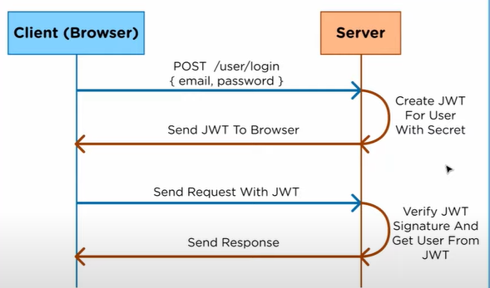
Authorization & Authorization with JWT

Slide 9
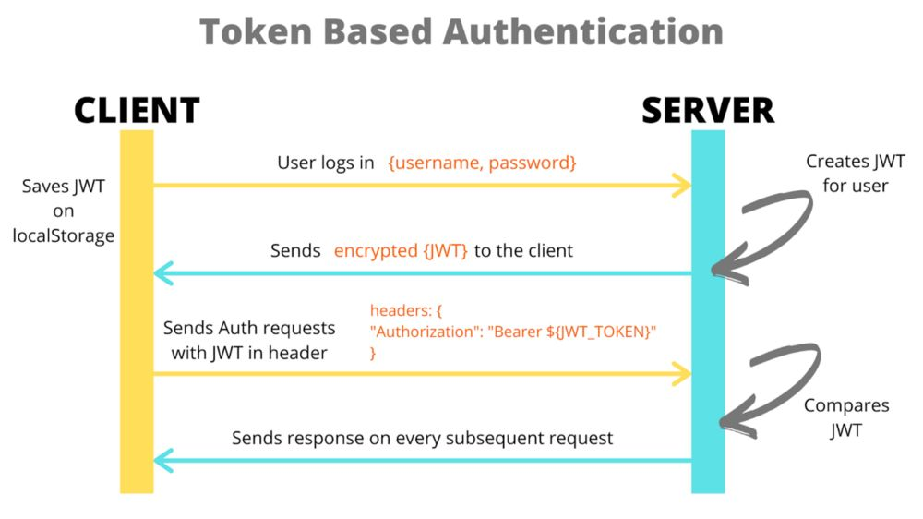

Slide 10
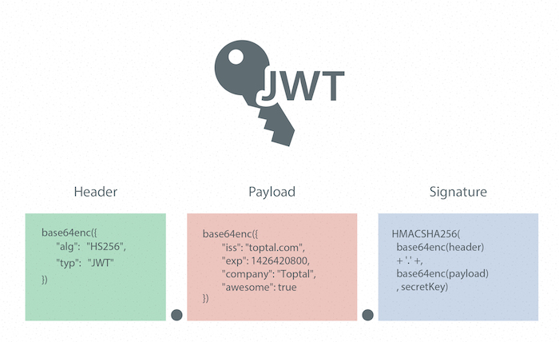

Slide 11
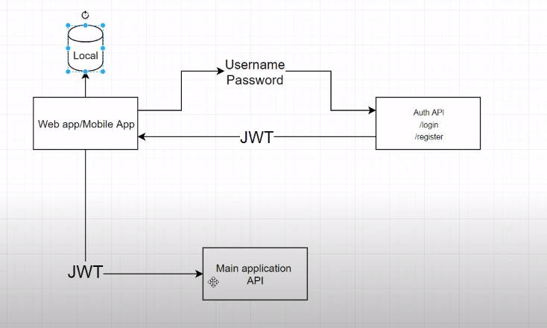
Refresh Tokens

Slide 12
